Slide 1
VOCABULARY
Canal – a waterway that is built for irrigation, drainage, or navigation
Ferryboat – a boat used to transport passengers, vehicles, or goods across a body of water
Caisson – a watertight structure inside of which construction work is done under water, as in the building of tunnels, bridges, or damns

Slide 2
TIMELINE
1803 – The Louisiana Purchase more than doubles the size of the United States
1825 – the Erie Canal is completed
1830 – first passenger train service in United States
1849 – California gold rush
1861 – Civil War begins
1869 – Completion of the Transcontinental Railroad connecting Omaha, Nebraska to San Francisco, California
1856 – First bridge to cross the Mississippi is completed at Rock Island, Illinois
1874 – The Eads Bridge opens crossing the Mississippi River at St. Louis, Missouri

Slide 3
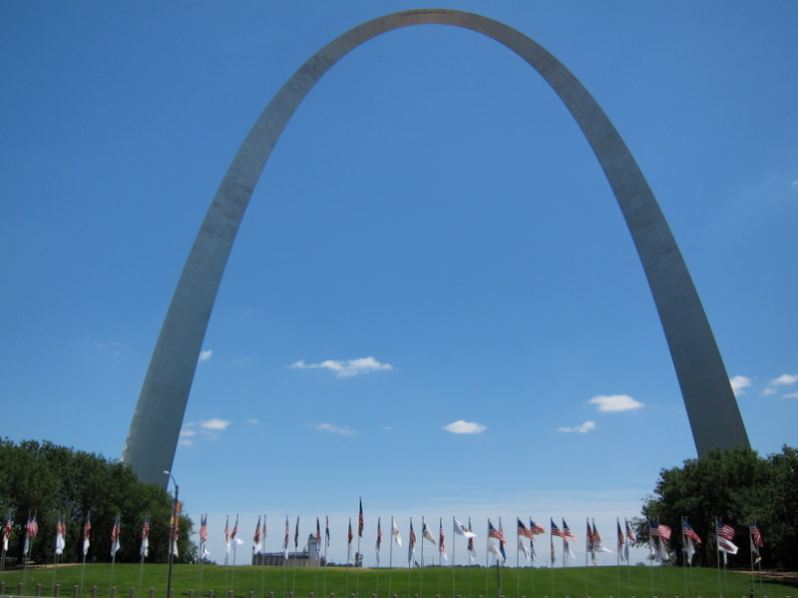

Slide 4
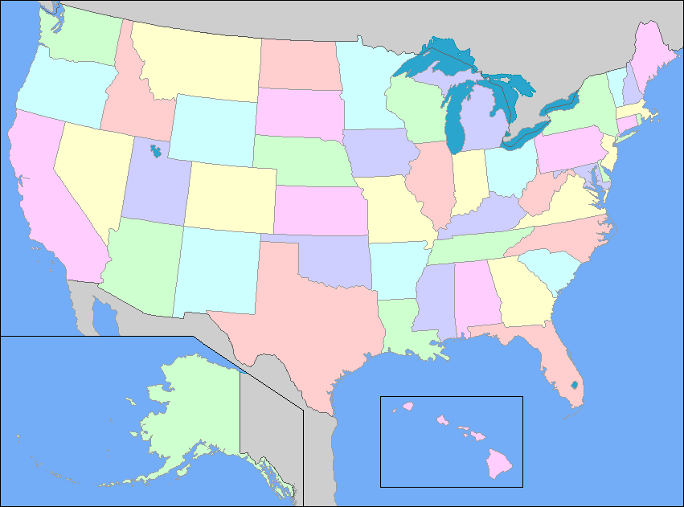

Slide 5
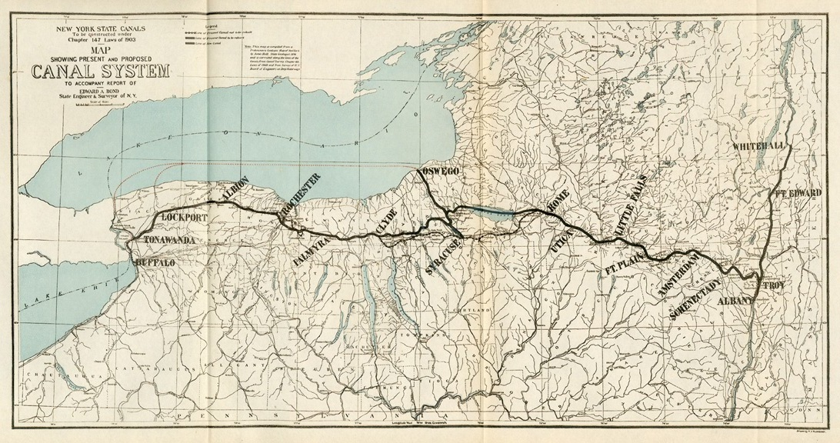

Slide 6
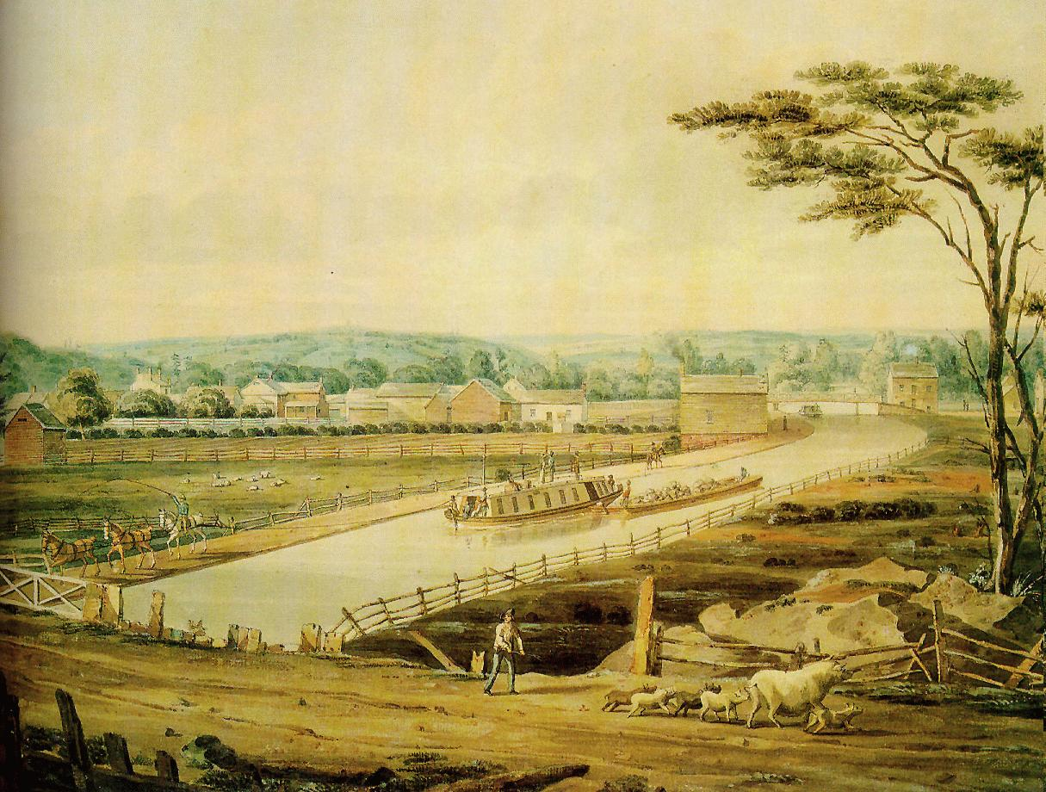

Slide 7
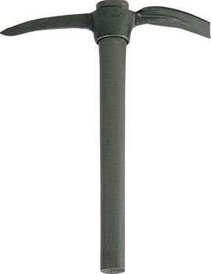

Slide 8
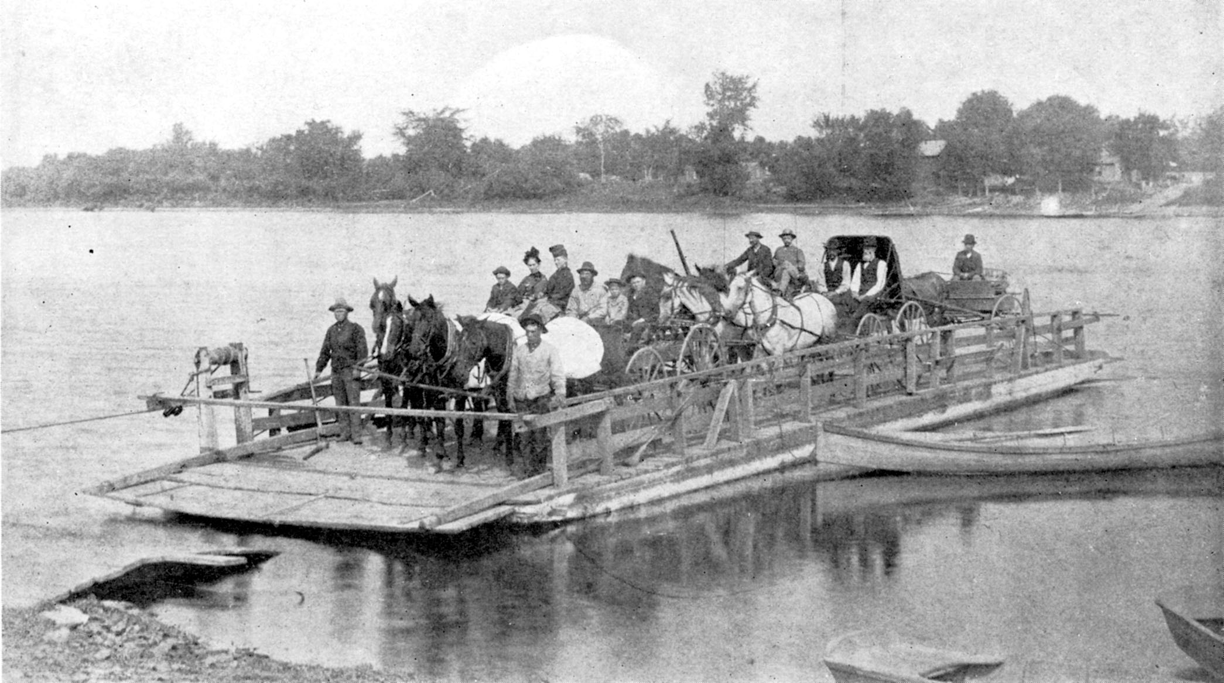

Slide 9
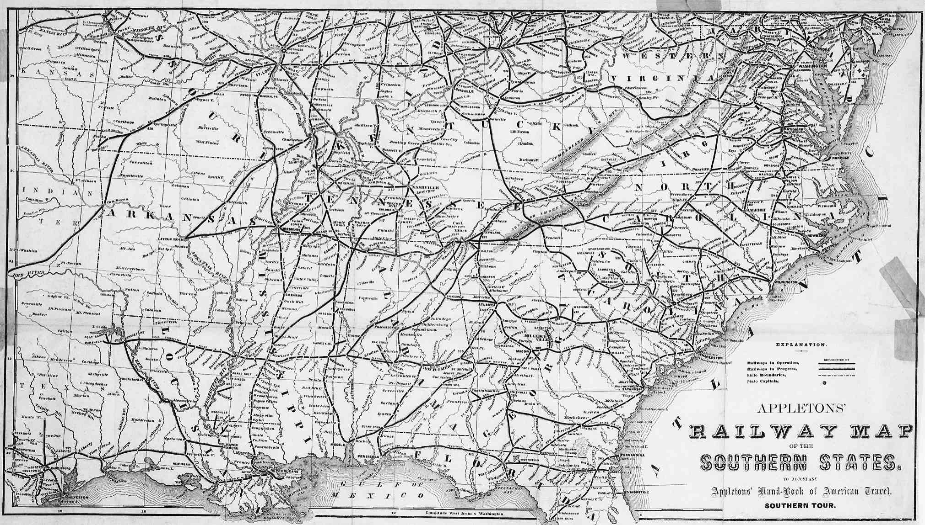

Slide 10
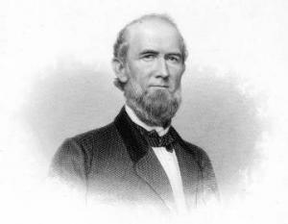
JAMES EADS

Slide 11
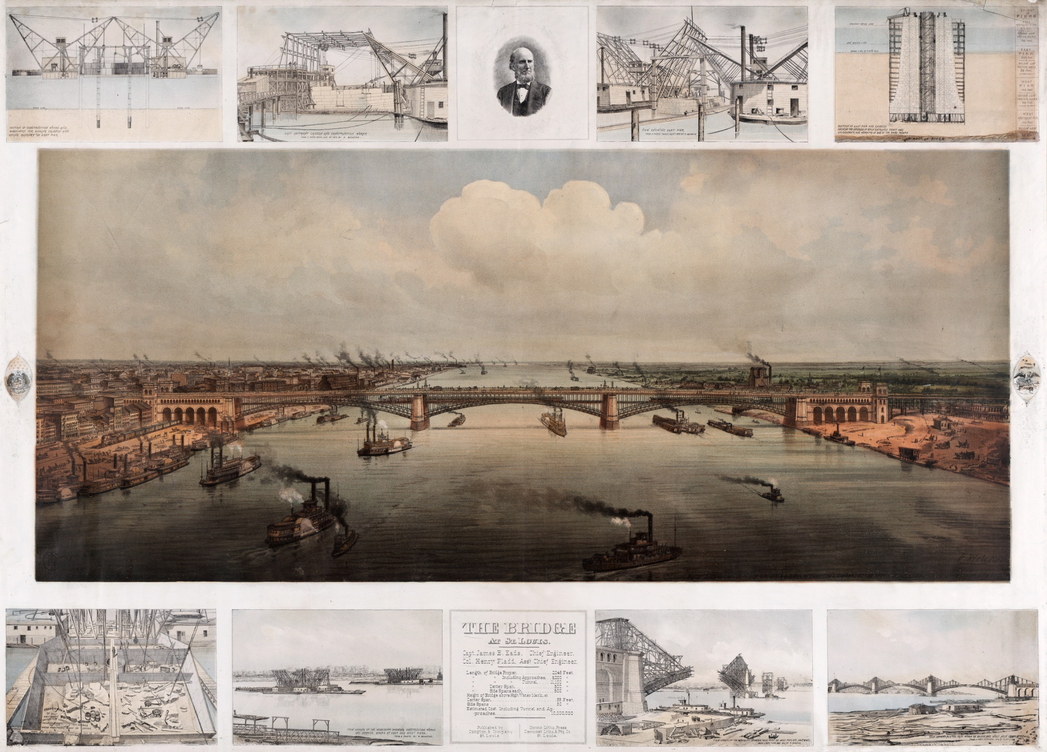

Slide 12
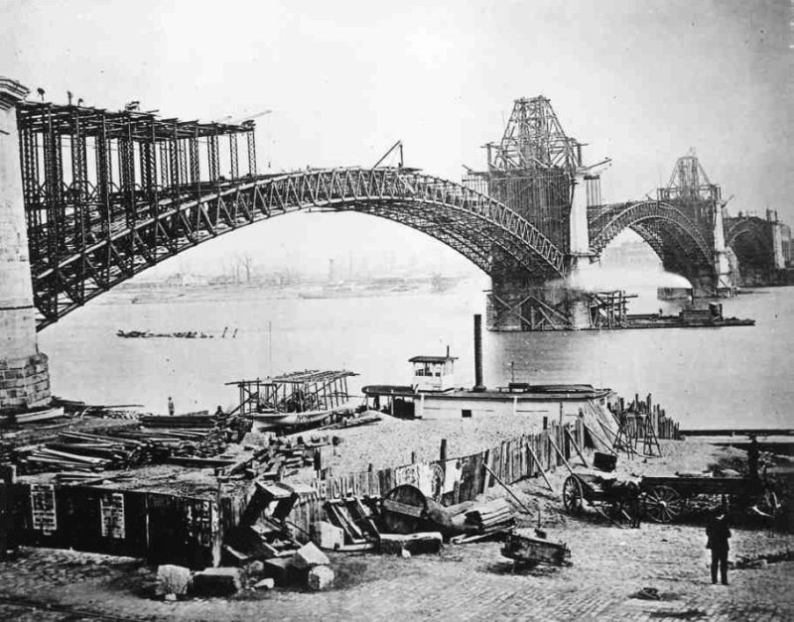

Slide 13
INTERESTING FACTS
Eads Bridge was the first bridge James Eads built
The bridge was officially opened on July 4, 1874
The bridge was considered an engineering marvel of its time
Eads Bridge was the first steel arch bridge
At its completion the bridge was the biggest bridge of the time
The bridge has two decks, one for rail traffic and one for cars
The rail bridge closed in 1974 and re-opened for use by the St. Louis light rail in 1994
The roadway deck closed in 1991, was rebuilt, and reopened on July 4, 2003

Slide 14
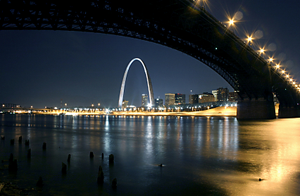

Slide 15
SOURCES
Books
Dupre, Judith. Bridges: A history of the world’s most famous and important spans. New York, NY: Black Dog & Leventhal Publishers, 1997.
Warburton, Lois. Railroads: Bridging the Continents. San Diego, CA: Lucent Books, Inc., 1991.
Articles
“James B. Eads and His Amazing Bridge at St. Louis.” The Museum Gazette. January, 2001. From the National Park Service, U.S. Department of the Interior.

Slide 16
Legal Documents and Government Publications
Bond, E. A.. Map showing present and proposed canal system. Annual report of the State Engineer and surveyor of the State of New York, for the fiscal year ending September 30, 1903. Facing page 60. www.eriecanal.org/maps accessed 2/22/2013.
Internet/WWW sites
Maps and Charts
Appleton. Railway Map of the Southern States. www.loc.gov/teachers/classroommaterials/connections/railroad-maps/file.html accessed 2/22/2013
“Railroad map 3”. National Park Service. www.nps.gov/nr/twhp/wwwlps/lessons/9stlouis/9locate3.htm
Accessed 2/22/2013

Slide 17
Photographs
Hill, John W.. “View of the Erie Canal .” From the New York Public Library. I.N. Phelps Stokes Collection of American Historical Prints.
Watercolor. www.eriecanal.org/images
Unknown. “Eads Bridge Construction.” Erection of west and center arches, view looking Northeast., September 1873. http://collections.mohistory.org/phptp/PHO: 13958 accessed 2/22/2013
Unknown. “Red Wing MN Ferry.” Photograph. 1873. www.pastblog.areavoices.com accessed 2/22/2013
Welker, F.. “The Bridge at St. Louis.” St. Louis: Compton & Co., 1874. Chromolithograph. http://commons.wikimedia.org/wiki/Library_of_Congress accessed 2/22/2013

