Slide 1
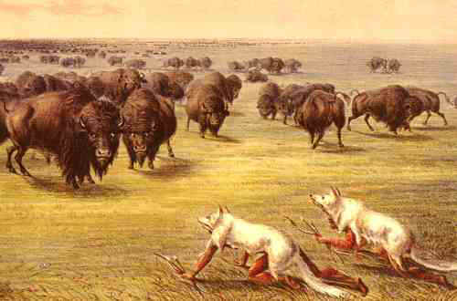
The Buffalo Hunt
By: Chad Folsom

Slide 2
Essential Vocabulary
Sacred
Stampede
Flourished
Ranged
Stalking
Migrated
Devastation
Delicacy

Slide 3
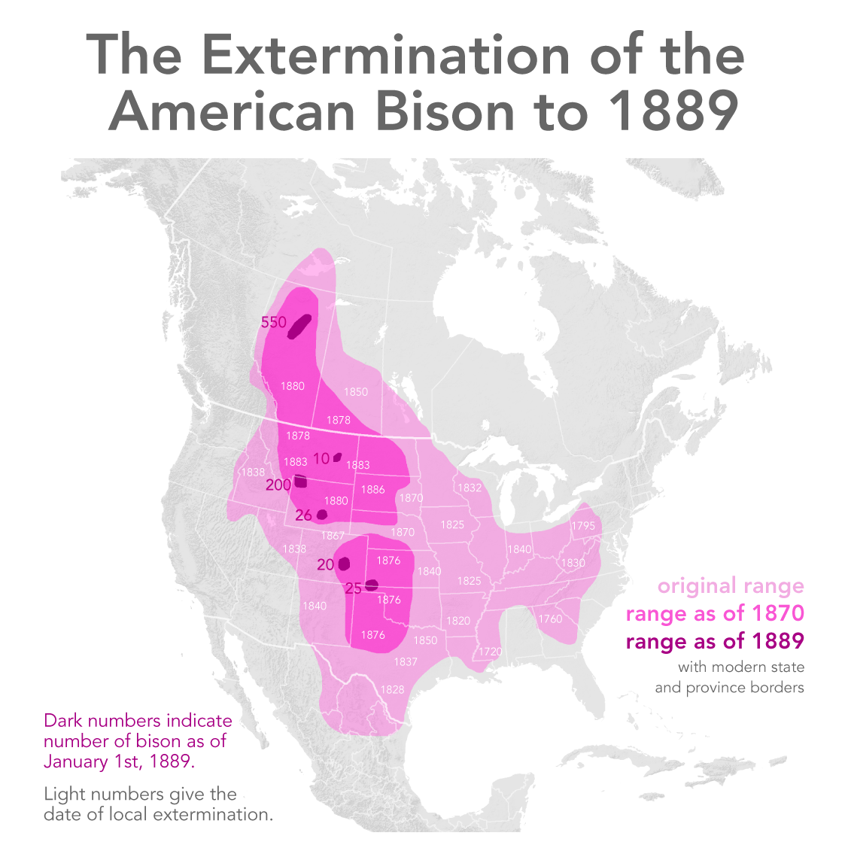
- From the map, what do you notice
about the colors by looking at the
key?
Do you notice any sort of pattern
with the lighter shaded dates?
What can you tell me about the
number of buffalo before the 1870s
compared to the amount of buffalo
in the late 1800s?

Slide 4
Importance of the Buffalo
Ask yourself: What things do we do for ourselves that ensure our physical survival?
Of all of the animals on the plains (deer, antelope, buffalo), why do you think the buffalo was the top choice for Indian hunters?
What were some of the resources that the Plain Indians could use off of the buffalo?

Slide 5
- What do you know from looking at the picture? - Who are the people in the document? - What do you notice about what the people are wearing? Why would they be wearing that? - What kind of dangers could the people be facing? Why?

Slide 6
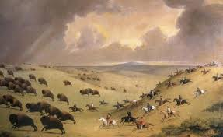
The Lakota Buffalo Hunt
Lakota Buffalo Hunt
While you’re watching think about these questions:
What kind of people did you see hunting the buffalo?
How many different ways in the video did you see the Native Americans using parts of the buffalo?
What were some of the risks involved in hunting the buffalo?

Slide 7
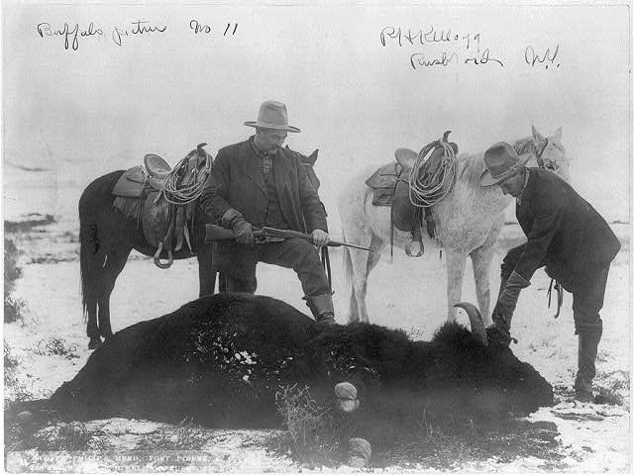
Then things changed...
What do you notice about the people in this picture?
Do you see any weapons that are different compared to the Native Americans?
Why do you think that these people are doing what they are pictured doing in the photo?

Slide 8
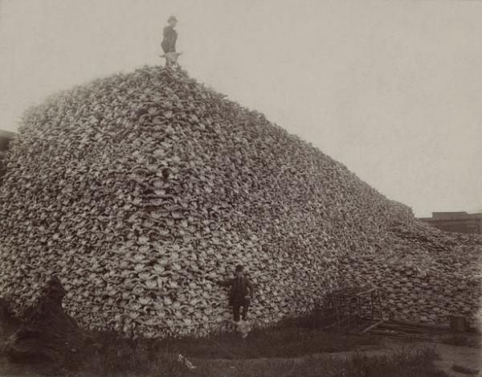
Killing Bison to Kill Off the Native Population
What do you notice that the white men are holding on to?
How could killing of the bison potentially kill off the Native American population?

Slide 9
